Slide 1

Data Mining - J Component Review 2
Title: Impact of Lifestyle and Diet In Combating
SARS-2 COVID-19 In India.
Team Members:
Swetha S - 20MCA1008
Abirami R - 20MCA1024
Mridul Nathani - 20MCA1029
Faculty:
Dr. Punitha K
Notes:
1

Slide 2
Abstract
Background : The world is experiencing an unprecedented challenge due to the corona virus disease (COVID-19) pandemic. Whether there is an association between lifestyle behaviors, diet and the acquisition of COVID-19 remains unclear.
Objective: The aim of this project is to analyze the role played by lifestyle behavior and diet followed among the general population in India in controlling the widespread outbreak of coronavirus (covid-19) pandemic.
Notes:
2

Slide 3
Abstract
Methodology: An online survey will be conducted among the general population in India with distinguishing parameters ranging from physical exercise, diet intake etc., Data mining techniques and various predictive models(KNN, Decision Tree etc.,) will be deployed in evaluating the result.
Notes:
3

Slide 4
Data Mining Process
Problem formulation
Data collection
subset data: sampling might hurt if highly skewed data
feature selection: principal component analysis, heuristic search
Pre-processing: cleaning
name/address cleaning, different meanings (annual, yearly), duplicate removal, supplying missing values
Transformation:
map complex objects e.g. time series data to features e.g. frequency
Choosing mining task and mining method:
Result evaluation and Visualization:
Knowledge discovery is an iterative process

Slide 5
Data Mining Process
Problem Formulation:
Real-time Data Collection using Questionnaire type of Google Form. Asking Questions regarding Lifestyle and Diet during COVID-19. Choosing the right questions that will give out attributes for precise decision making.
Data collection:
Data Collection is the most important task in this Data Mining J component. We have collected data by circulating a Google Form among general audiences.

Slide 6
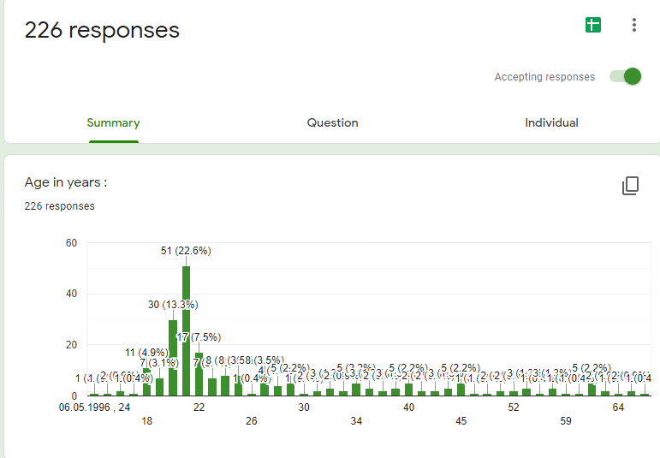
Process…
Data collection:
For the first review we have captured raw responses that will be further processed under pre-processing cleaning.
Link For Google Form:
https://forms.gle/J42gPGDMXCA6rme66

Slide 7
Process…
Pre-processing: cleaning
Duplicate removal, supplying missing values.
Transforming the RAW data and transform it in a useful and efficient format.
It involves cleaning Missing Data, Noisy Data etc.

Slide 8
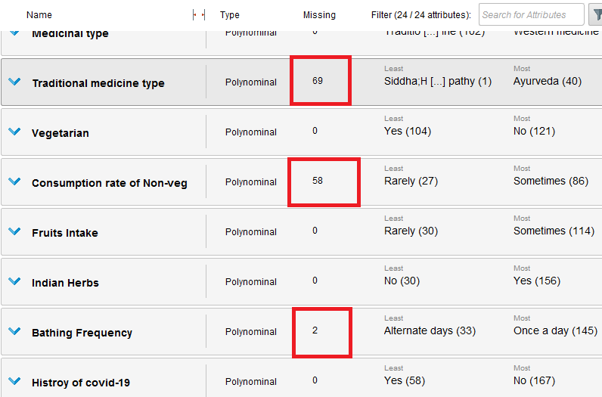

Slide 9
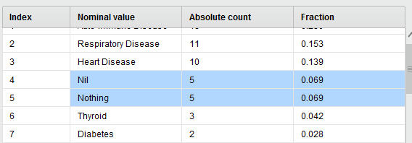

Slide 10
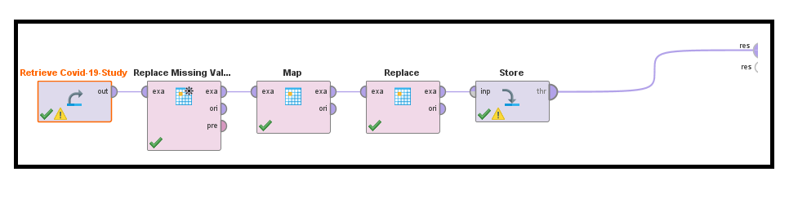

Slide 11
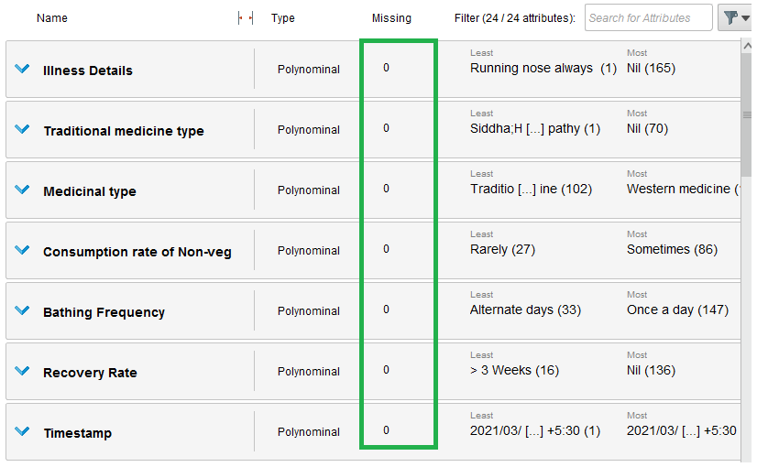

Slide 12
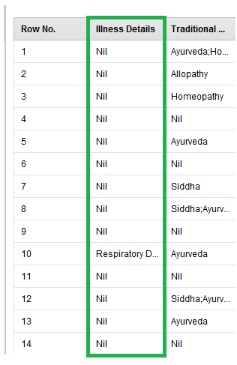

Slide 13
Data Modelling
For data modelling we are using an efficient tool that is “Rapid Miner”.
RapidMiner Studio is a powerful data mining tool for rapidly building predictive models. The all-in-one tool features hundreds of data preparation and machine learning algorithms to support all your data mining projects.

Slide 14
Bayesian learning
Assume a probability model on generation of data.
Apply baye’s theorem to find most likely class as:
Naïve baye’s: Assume attributes conditionally independent given class value
Easy to learn probabilities .
Useful in some domains e.g. text
Handles both discrete and continuous data.

Slide 15
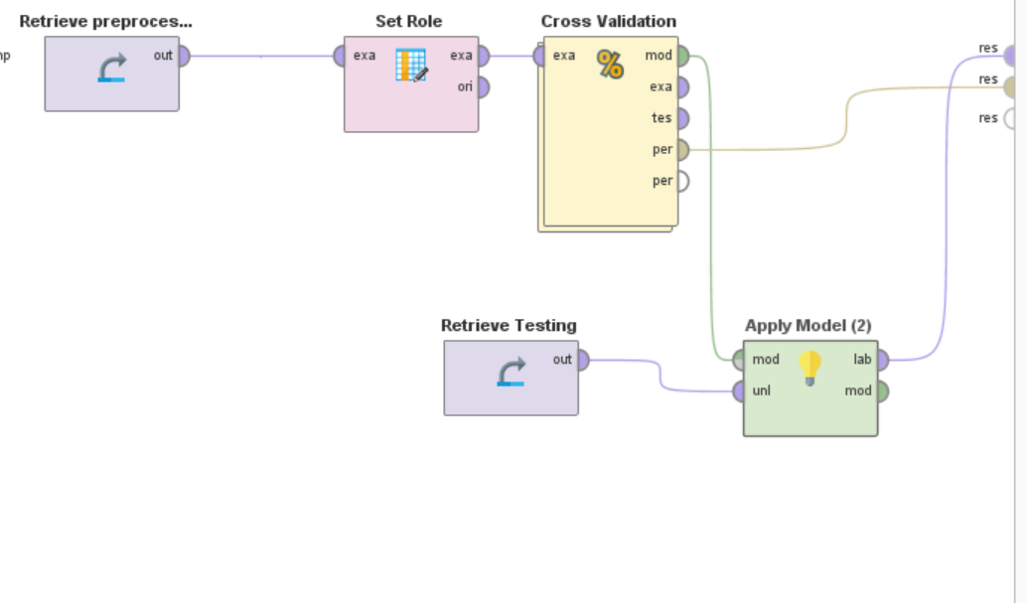
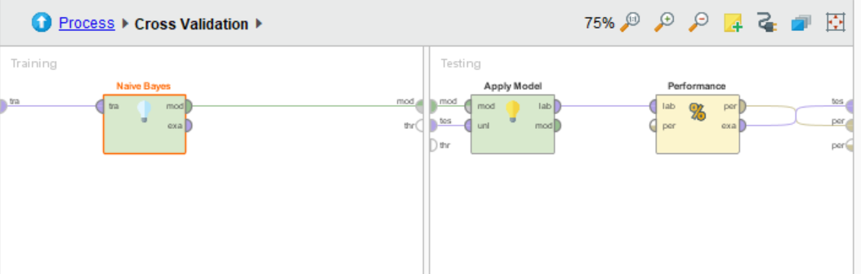
Snippets of the process:
The idea is to do a predictive classification model in-order to classify the people who are more likely and less likely to have covid-19.

Slide 16
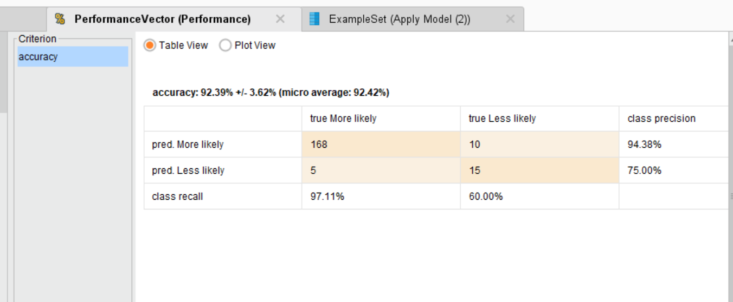
Results:

Slide 17
Further Implementation
We will be passing out more Google Forms to get significant amount of RAW data.
For data modelling we will be using the same tool i.e. “Rapid Miner”.
Other few Model’s that we will be implementing are KNN and Random Forest.
We will try to enhance the performance and predictive percentage of Our dataset.

Slide 18
Nearest Neighbor (KNN)
Define proximity between instances, find neighbors of new instance and assign majority class
Case based reasoning: when attributes are more complicated than real-valued.
Pros
Fast training
Cons
Slow during application.
No feature selection.
Notion of proximity vague
Notes:
18

Slide 19
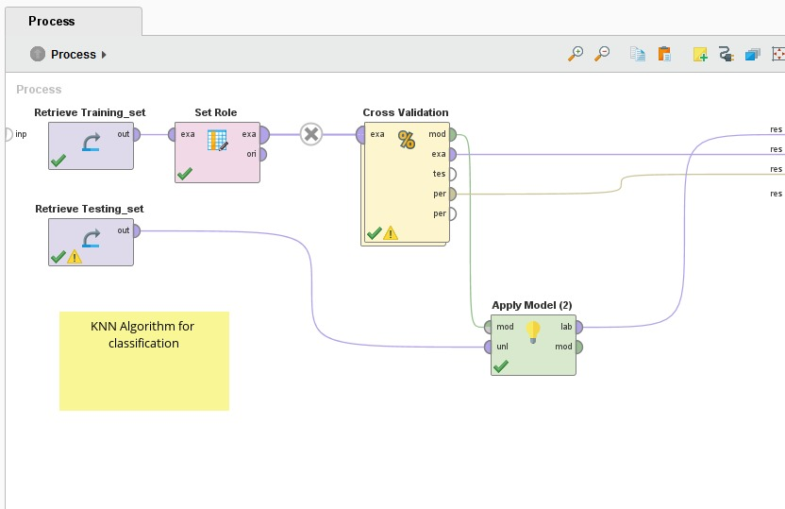
Snippets of the process:
Notes:
19

Slide 20
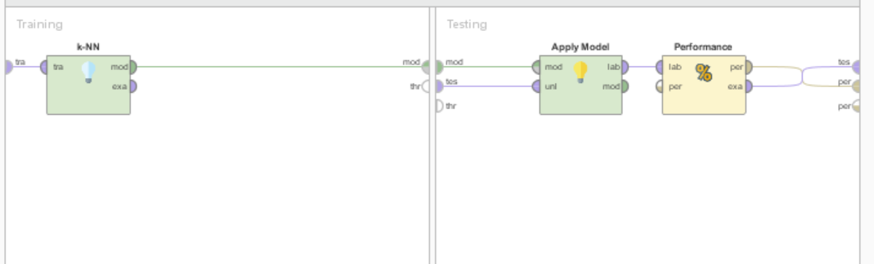
Notes:
20

Slide 21
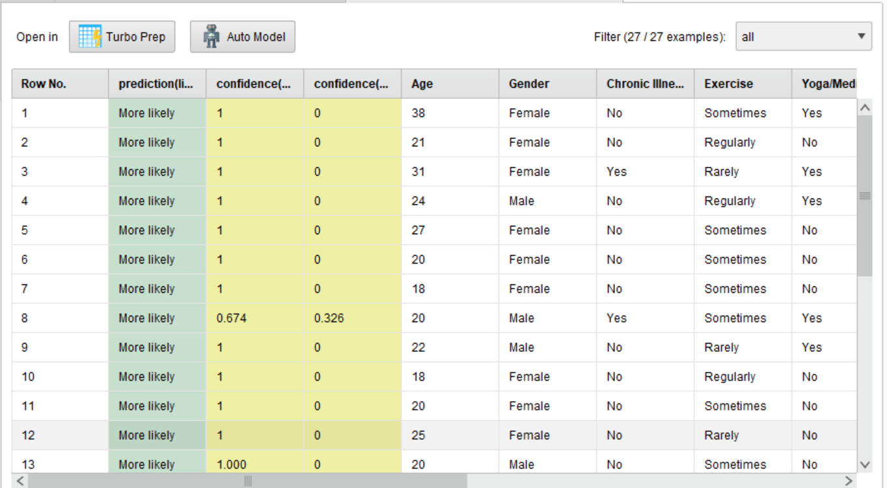

Slide 22
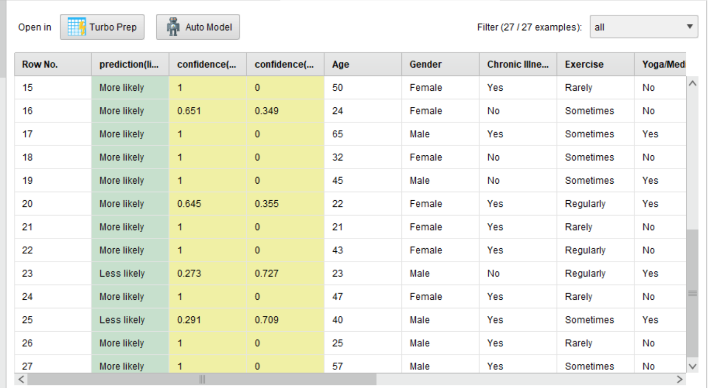

Slide 23
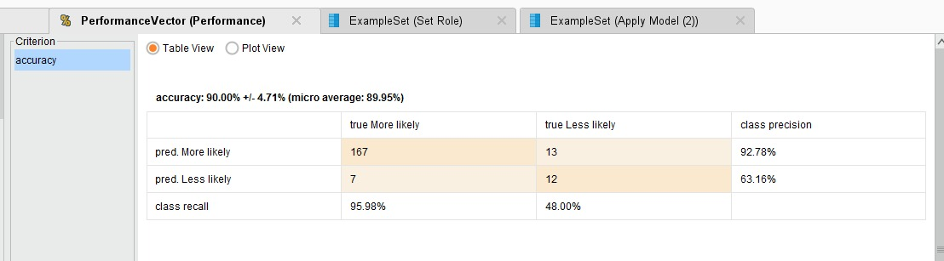
Results:
Notes:
23

Slide 24
Random Forest:
Random forest, like its name implies, consists of a large number of individual decision trees that operate as an ensemble.
Each individual tree in the random forest spits out a class prediction and the class with the most votes becomes our model’s prediction.

Slide 25
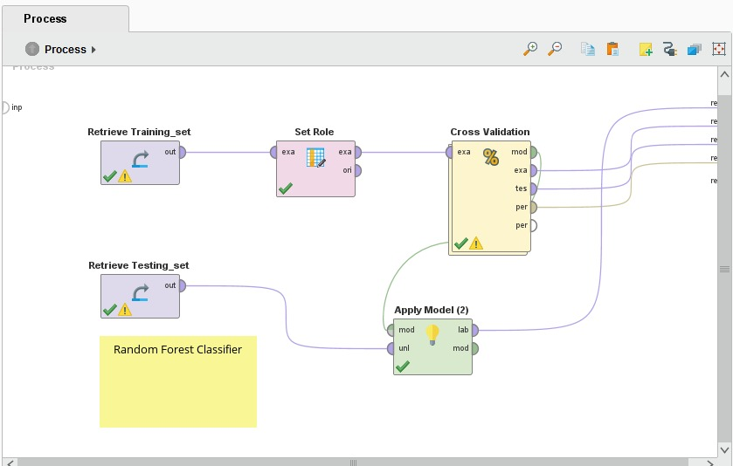
Snippets of the process:
Notes:
25

Slide 26
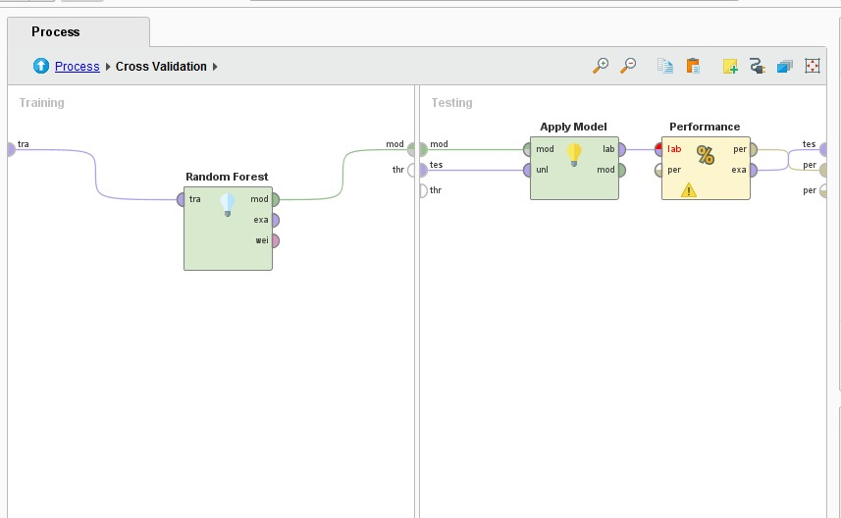
Notes:
26

Slide 27
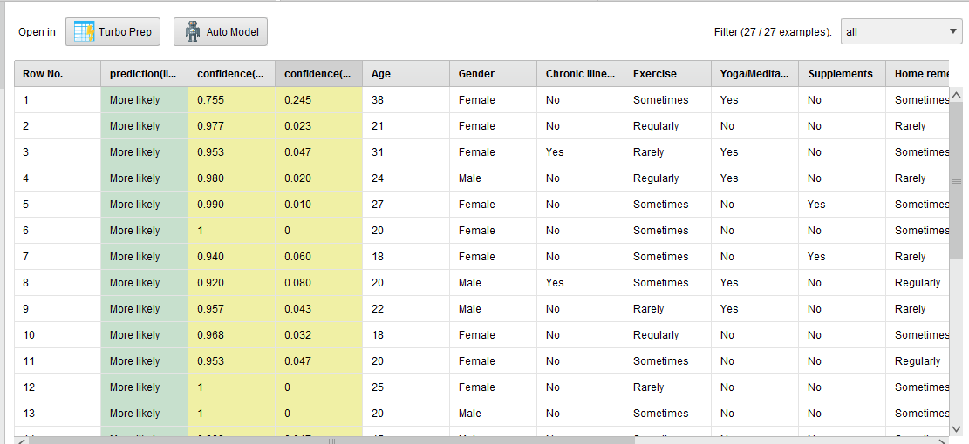

Slide 28
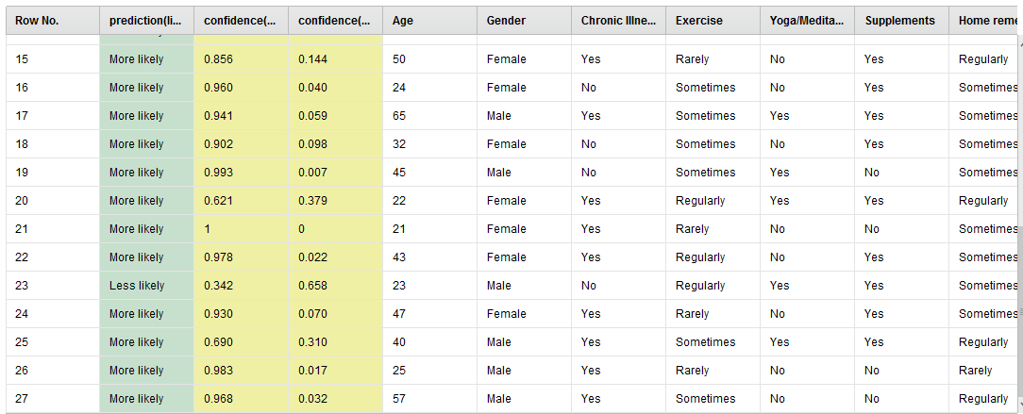

Slide 29
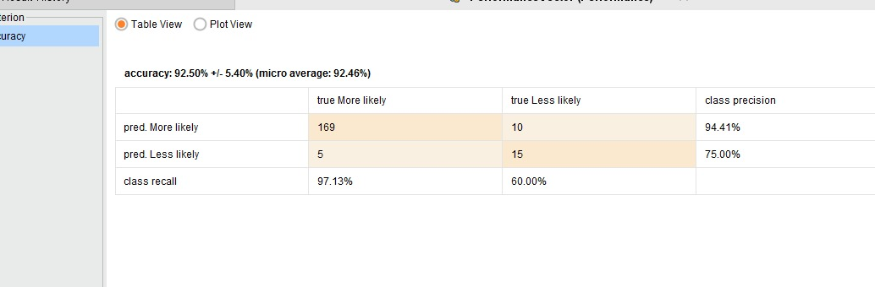
Results:
Notes:
29

Slide 30
Comparison of the models:

Slide 31
Thank You !

